Slide 1

Modular Pipeline for
Gender Bias Migration
in Short Texts
Names:
Katherine Zablianov
Ariel Soffer
Shy Yeffet
Neta Robinzon Butbul

Slide 2
Modular Pipeline for Gender Bias Mitigation in Short Texts
Problem:
Natural Language Inference (NLI) systems often make gender-based assumptions when the context is insufficient. These assumptions can reflect harmful stereotypes and introduce social bias into applications like chatbots, search engines, or summarization tools.
Why it's important:
Biased language models can reinforce social inequalitie.
Misgendering and unwarranted gender inference harm user trust and fairness.
Ensuring balanced gender representation in AI outputs is essential for ethical deployment
Why it’s hard:
Gender bias in natural language is often subtle, contextual, and embedded in seemingly neutral language .
Many professional or social roles do not imply gender, but models often infer one anyway.
Addressing this requires context-aware detection and careful controlled rewriting of outputs.
Notes:
2

Slide 3
Modular Pipeline for Gender Bias Mitigation in Short Texts
Problem:
Natural Language Inference (NLI) systems often make gender-based assumptions when the context is insufficient. These assumptions can reflect harmful stereotypes and introduce social bias into applications like chatbots, search engines, or summarization tools.
Why it's important:
Biased language models can reinforce social inequalitie.
Misgendering and unwarranted gender inference harm user trust and fairness.
Ensuring balanced gender representation in AI outputs is essential for ethical deployment
Why it’s hard:
Gender bias in natural language is often subtle, contextual, and embedded in seemingly neutral language .
Many professional or social roles do not imply gender, but models often infer one anyway.
Addressing this requires context-aware detection and careful controlled rewriting of outputs.
Notes:
3

Slide 4
Modular Pipeline for Gender Bias Mitigation in Short Texts
Detect gender bias in text.​
Rewrite biased sentences to neutral ones without changing the meaning.
​
Tasks + Data:​
Classifier Model:
Model: bert-base-uncased model
Fine-Tuned on: MGSD (Merged Gender Stereotype Dataset) - consisting labeled sentences (gender biased/ neutral)
Output: Bias score (range 0–1)
Threshold: 0.5 (for classification as biased)
Evaluation: f1_score, accuracy, precision, recall metrics, tested on test_df from MGSD
Rewriting Method 1 – IG + Pretrained:
Model: uses FLAN-T5 model for rewriting
Tool: uses Integrated Gradients to identify top-k biased tokens
Input: gender biased sentences that were classified as biased (in our classifier)
Output: rewritten version of the original sentence with less (hopefully without) gender bias
Notes:
4

Slide 5
Modular Pipeline for Gender Bias Mitigation in Short Texts
Rewriting Method 2 — Fine-Tuned Rewriter:
Model: T5 (Text-To-Text Transfer Transformer)
Fine-Tuned on: winobias_gold_pairs - pairs of gender-biased sentences and their unbiased versions (biased, neutral)
Output: rewritten version of the original sentence with less (hopefully without) gender bias
Strategy and step-by step plan:
Entering a sentence into the pipeline
The sentence is classifies to biased/not biased
If it is classified into biassed it goes through our 2 methods of rewriting
The two rewritten sentences are then presented as an output
Remark: We will preprocess all of our datasets, make sure there are no nulls, plot distribution and make sure the data is balamced, extract only the relevant columns and so
Once pipeline is trained and evaluated, it can be integrated with GPT models or used as a smart pre/post-processing layer
M
Notes:
5

Slide 6
Evaluation – bias reduction and meaning preservation
Evaluate bias reduction in both rewriting models:
Using SEAT (Sentence-level association test) and WEAT (Word embedding association test ) on outputs to assess whether latent gender associations are reduced
Using our bias classifier again with the rewritten sentences to check if the bias was reduced
Evaluation of the rewriting models - Meaning Preservation:
First Rewriting Model evaluation (IG + Pretrained Model):
Blacklist N-gram removal: Are flagged biased words removed
Cosine Similarity between original and rewritten embeddings
Second Rewriting Model evaluation (Fine-Tuned Rewriter):
Rouge and BERTScore metrics (paired biased vs. neutral reference)
Cosine Similarity between original and rewritten embeddings
We will also calculate a fluency Score using GPT perplexity
Notes:
6

Slide 7
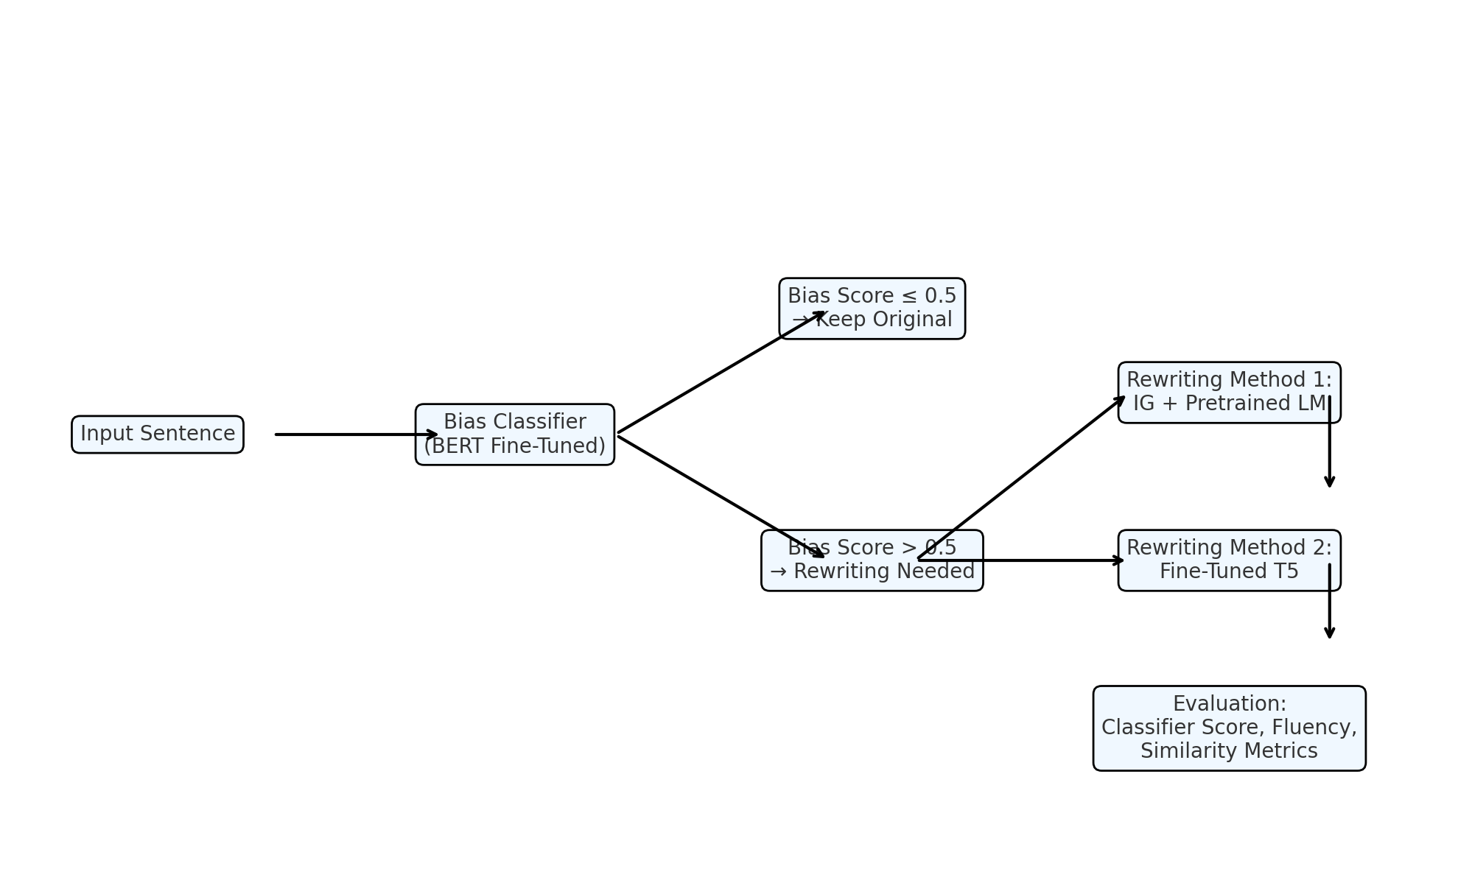

Slide 8
Previous Work
Source / Title | Approach / Model | Data | Metrics | Results
Dbias: Detecting Biases and Ensuring Fairness in News Articles (2022) | Two-stage pipeline: BERT-based classifier → GPT-2 rewriter with reward optimization | BiasFinder + custom news data | Classifier bias score, human judgment | Reduced bias scores by ~20%, and human judges preferred rewritten versions 79% of the time
From ‘Showgirls’ to ‘Performers’: Fine-tuning with Gender-inclusive Language (2024) | Fine-tuned LLMs with gender-neutral term replacements | Gender-transformed corpora + CrowS-Pairs | Stereotype score (CrowS-Pairs, StereoSet) | Reduced stereotype scores by 11% (RoBERTa) and 15% (GPT-2), with minimal loss in fluency
An Empirical Analysis of Parameter-Efficient Methods for Debiasing Pretrained LMs (2023) | Adapter, prompt, and LoRA tuning on BERT and GPT-2 | CrowS-Pairs + StereoSet | Stereotype score, perplexity | Adapter tuning lowered stereotype scores by up to 18% with <1% increase in perplexity (maintained fluency)

Slide 9
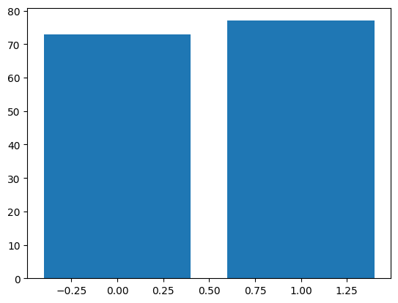
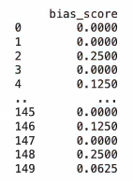
Baseline for classification:
Dataset: 150 sentences sampled from the MGSD dataset Each sentence manually labeled as biased or neutral
Focus on gender-related bias only Sentences vary in length and grammatical structure
Baseline: Use a dictionary of gendered and stereotypical keywords Classify sentence as biased if any keyword is matched Compute a bias score as the ratio of matched keywords to total tokens Evaluate on full 150-sentence set Report accuracy, precision, recall, and F1 score
Evaluation Metrics:
Accuracy : 0.49 Precision: 0.50
Recall : 0.57 F1 Score : 0.53
Baselines
Notes:
9

Slide 10
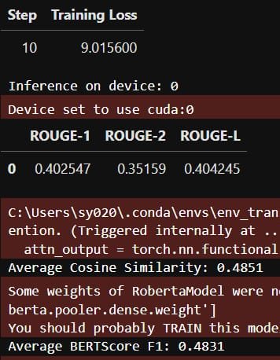
Baseline for rewriting model:
Dataset: 150 sentence pairs from winobias_gold_pairs.csv Each example contains a biased sentence and its manually crafted neutral rewrite
Split: 100 examples for training, 50 for testing Sentence lengths vary
Baseline: Fine-tune T5-small on 100 biased → neutral examples, trained on 1 epoch
Format inputs as: "neutralize: [biased sentence]" testing is done on the first 50 held-out examples Output: rewritten neutral sentences generated from biased inputs
Evaluation metrics we used in the baseline are Rouge (1, 2, L) for measuring word-level and phrase-level similarity, cosine similarity to measure semantic similarity between the original biased sentence and its rewritten neutral version, and BertScore to To evaluate semantic overlap at the token level using BERT embeddings (it validates that the rewrite still means the same thing)
Baselines
Notes:
10

Slide 11
Insights
The dictionary- based classifier method for classification provided relatively low accuracy (accuracy = 0.49, f1_score = 0.53), indicating that the dictionary was too general
we need to find more specific words that affect the bias in each sentence and capture specific nuances of bias
The bias score represents the ratio of biased words from the dictionary to the number of words in the sentence. It is very low in most cases
Therefore, it does not truly reflect the level of gender bias and we will change the way it is calculated so that it can measure the true level of bias
The model shows moderate surface similarity to references (ROUGE-1: 0.40, ROUGE-2: 0.35) Therefore, we will train on a larger dataset (as expected) to improve pattern learning and structural fluency
The semantic preservation is weak (Cosine: 0.48, BERTScore F1: 0.48) — rewrites often drift in meaning So we will Add semantic-aware training (e.g., embedding-based loss) and use guided editing with IG

